Slide 1
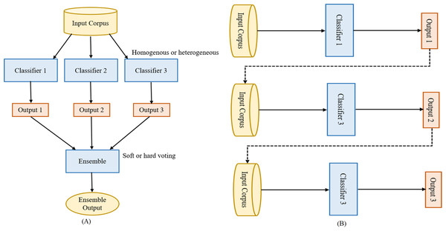
Ensemble Learning (The Power of Crowds)
Why Many Models are Better than One
Instructor: Zaryab Ahmad Khan

Slide 2
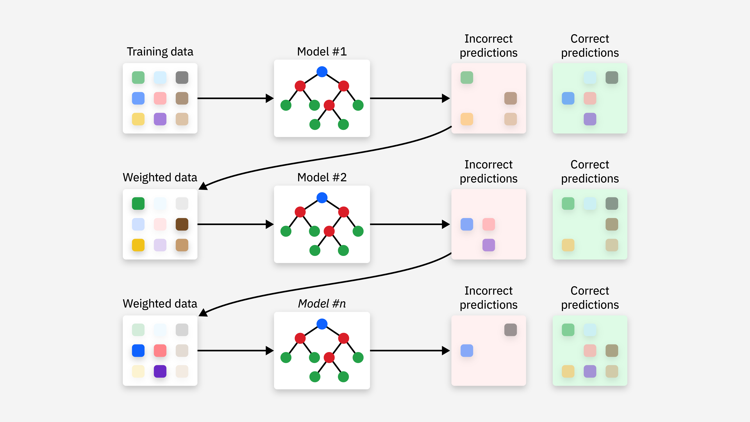
What is Ensemble Learning?
The Concept: It is the idea that 100 average models voting together are significantly more accurate than one highly intelligent model alone.
Analogy: A "Jury" in court. One judge might have a bias, but 12 jurors voting together are more likely to reach a fair verdict.
The Goal: Reduce errors and prevent overfitting by averaging out the mistakes of individual models.

Slide 3
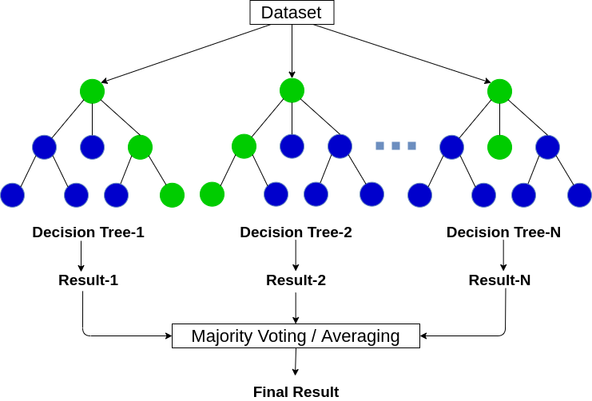
Random Forest (The Forest for the Trees)
Definition: A Random Forest works by building hundreds of different Decision Trees at the same time.
The Process: Each tree is trained on a slightly different random slice of the data.
The Prediction: For classification, the trees "vote" and the majority wins; for regression, the model takes the average of all tree predictions.

Slide 4
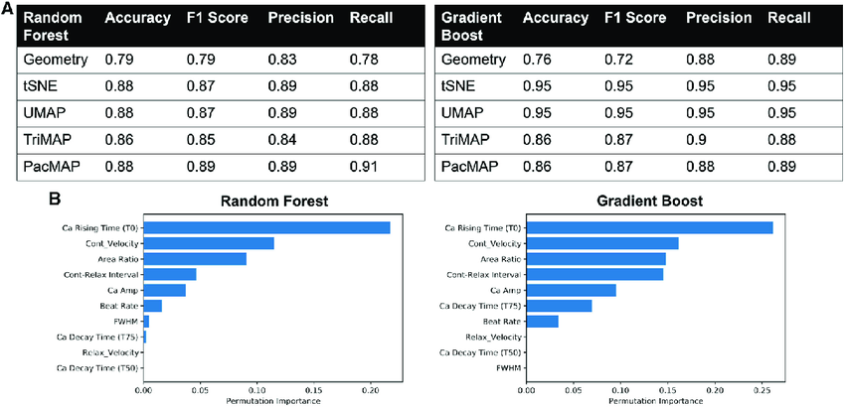
Feature Importance
The Question: "Which columns of my data actually matter?"
The Tool: Random Forests can mathematically rank which columns of data were the most helpful in making the final decision.
Usage: This helps us understand the "why" behind a prediction and allows us to remove useless data columns in the future.

